Slide 1


Parent Information Session
Anxiety in Children and Young People

Slide 2

&
Please feel free to ask questions
Notes:
Facilitators introduce self. We are here to give a basic overview of anxiety and answer any questions
Participants introduce themselves and say ages of their children.
Share what you want to share.
Look after yourself
Please feel free to ask any questions

Slide 3

What we will cover in this session
• Understanding what anxiety is
• Some basic strategies to help manage symptoms of anxiety
When to ask for extra support

Slide 4
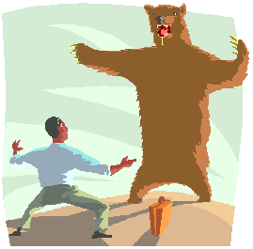
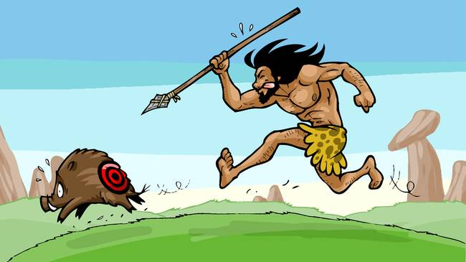
What is Anxiety?
Fight / flight
Caveman story
Notes:
Briefly describe flight or flight response and then read out the caveman story

Slide 5

What is Anxiety?
Notes:
We need a degree of anxiety to survive ,it is a ‘normal’ part of everyday life but it is important to differentiate between normal fears, worries, and shyness and anxiety.
Anxiety is related to fear, but while fear is an appropriate reaction to clear danger or actual threat, anxiety is the same reaction to a perception of danger or threat (like having our “on”-switch stuck like in the Story of the Caveman)

Slide 6
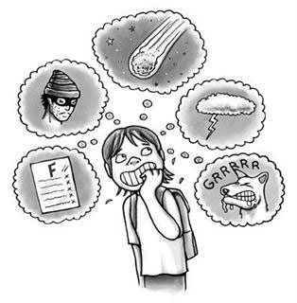
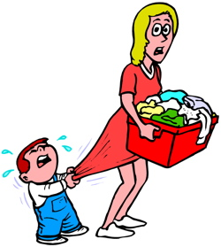
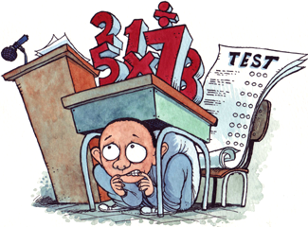
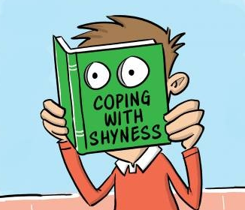
Types of Anxiety
Generalised Anxiety Disorder
Separation Anxiety
School Phobia
Social Anxiety
Notes:
Anxiety disorders are the most common mental health problem affecting children and young people.
Generalised Anxiety Disorder: Generalized Anxiety Disorder (GAD) is characterized by excessive worrying about a variety of events, including those in the past, present, and future. Children and young people with this disorder worry excessively about a number of issues, including past
conversations or actions, upcoming events, school, family health, their own health, competence in sports or academics, and world events. Typically, children and young people experiencing such excessive worry find it difficult to control the amount of time that they worry, and the worrying interferes in their daily life.
Separation Anxiety: Children with separation anxiety disorder have intense anxiety about being away from home or about their parents/caregivers that affects their ability to function socially and in school. These children have a great need to stay at home or be close to their parents. Children with this disorder may worry excessively about their parents when they are apart from them. When they are together, the child may cling to parents, refuse to go to school or be afraid to sleep alone. Repeated nightmares about separation and physical symptoms such as stomach-aches and headaches are also common in children with separation anxiety disorder
School Phobia: School phobia (also referred to as school refusal) is a complex and extreme form of anxiety about going to school and can have many causes. Young children with school phobia experience separation anxiety and cannot easily contemplate being parted from their main carer, whereas young people are more likely to have it take the form of social phobia where they are anxious about their performance in school
Social Anxiety: Social phobia usually emerges in adolescence. Young people with this disorder have a constant fear of social situations or when they have to perform such as speaking in class or eating in public. The fear is often accompanied by physical symptoms and the typical is to avoid the feared situation. Social phobia is different from shyness. People with shyness can be uneasy around others, but they don’t necessarily avoid situations that make them feel uncomfortable. Social phobia disrupts a child’s normal life, interfering with school or social relationships

Slide 7
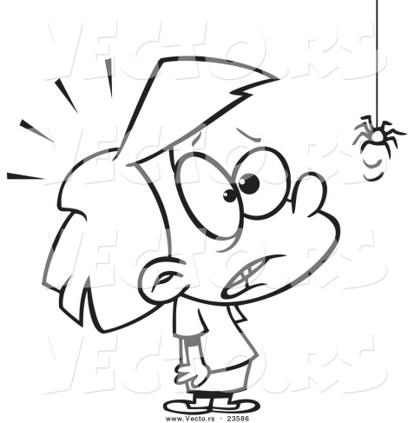
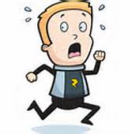
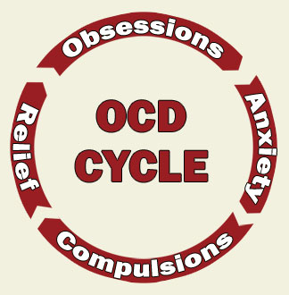
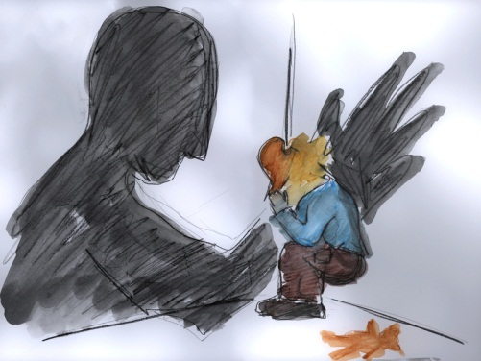
Types of Anxiety Disorders
Phobias
Panic Disorder
OCD
PTSD
Notes:
Phobias: Children and young people may experience specific phobias, which are intense, irrational fears of certain things or situations, (e.g., dogs, balloons, injections, the dark, escalators, flying, etc.). Children and young people may not realise that fear of such objects are unreasonable. Typically, children or young people will become extremely distressed when confronted with the feared object or situations
Panic Disorder: The key characteristic of panic disorder is recurring panic attacks. A panic attack is defined as an episode of intense fear and unease, comprised of both physical symptoms and a number of fearful thoughts.
OCD: Obsessive Compulsive Disorder. OCD can take many different forms, but is generally recognised as recurrent, intrusive thoughts, images or impulses. These thoughts are usually accompanied by compulsions which may take the form of either behavioural acts (such as washing or checking) or mental acts (such as repeating words or phrases or checking things in the mind). These compulsions often take up hours of each day and cause a lot of distress).
PTSD: Post Traumatic Stress Disorder. PTSD is an anxiety disorder which may develop following exposure to any one of a variety of traumatic events that involve actual or threatened death, or serious injury. The event may be witnessed rather than directly experienced. A child or young person may "re-experience" the trauma through nightmares, flashbacks or constant thoughts about what happened.

Slide 8
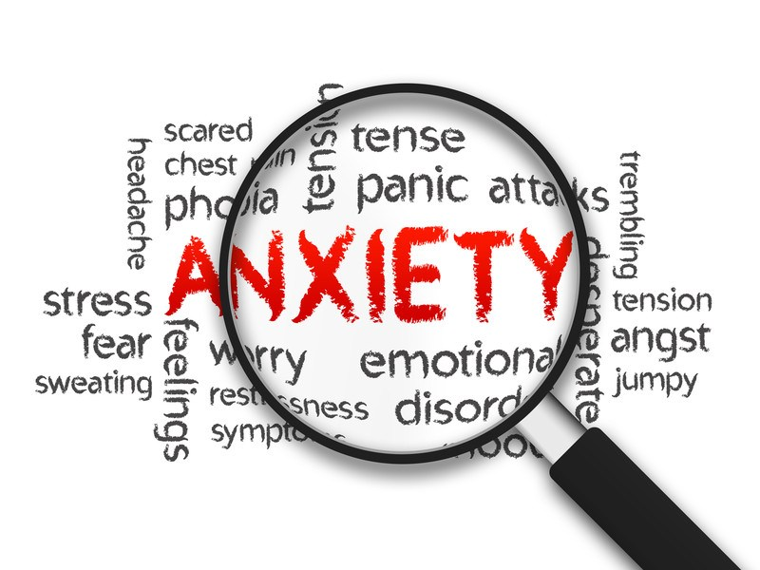
How Does Anxiety Develop?
There is no one cause for anxiety
Different children respond differently to similar experiences
Genetics
Learning/Modelling
Core beliefs
Triggers in the past
Brain Biochemistry
Fight or Flight Mechanism
Notes:
Core beliefs: Routes from external sources, e.g all spiders are dangerous and to be feared
Triggers in the past, e.g. phobia of balloons, a balloon may have popped near a child years ago when they were an infant or they may have seen someone in the past who was scared of balloons
Different children respond differently to similar experiences depending on their levels of resilience
Research shows a genetic predisposition for a chemical imbalance in people with anxiety
Modelling/ learning: Children model behaviours of others. If an adult around them is not managing their own anxiety, the child may model this. A child who grows up feeling that things are uncontrollable and unpredictable is more likely to develop anxiety.
Brain Biochemistry: Sometimes there is a problem with neurotransmitters (chemical messengers in the brain) due to chemical imbalance
Fight or Flight: Body responses to perceived threat(may misunderstand the situation), like in the ’story of the caveman’ the response is disproportionate to the threat.

Slide 9
Anxiety Symptoms: Behavioural
Seeks reassurance often
Avoids situations
Tries to get others to do the things they are worried about
Tells you they have physical pains
Dislikes taking risks or trying new things
Has lots of fears or worries
Gets upset easily
Disruptive / aggressive behaviours
Keeps constant tabs on people and things
Is always ‘on edge’ and unable to enjoy daily activities
Asks repeated questions and is not reassured by the answers
Constant clinging and withdrawal
Needing things just right (number, symmetry, evenness)
Spending unnecessary time on things
Not speaking or speaking quietly
Notes:
This list is not exhaustive
Many symptoms will co-exist with others: “CO-MORBIDITY”

Slide 10
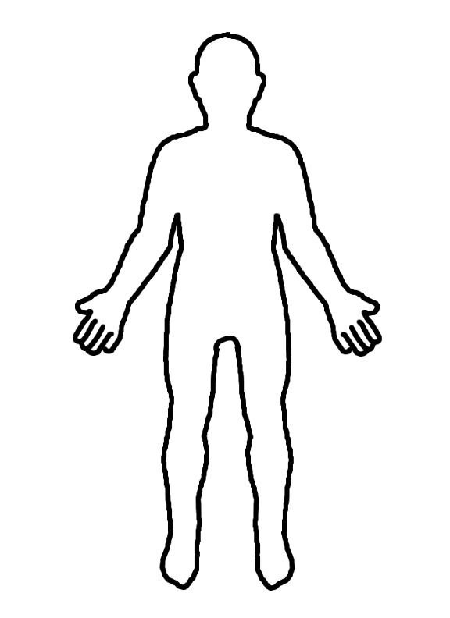
Anxiety Symptoms: Physical
Most people experience physical symptoms of anxiety.
Some children worry about these symptoms and do not associate them
with anxiety.
You can help children by explaining why they have the symptoms and reassuring them that the symptoms will not harm them and will go away.
Notes:
Activity – body outline – complete physical symptoms
Cortisol and adrenaline get released when anxious, this affects digestion and functions around the body.
Handout - adrenaline man

Slide 11
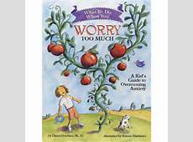
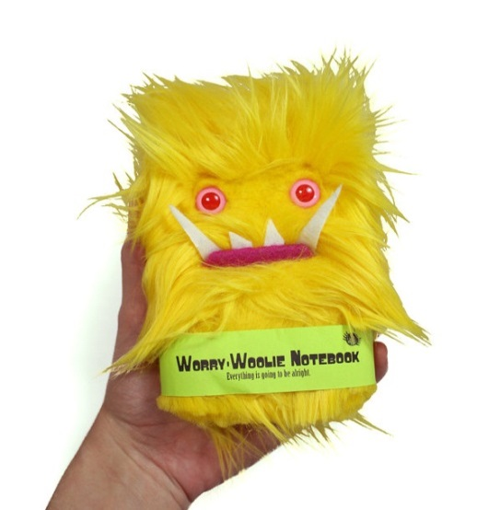
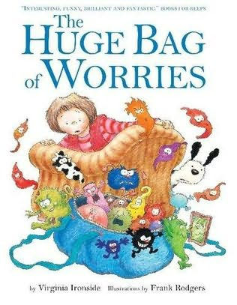
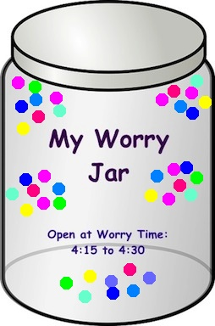
Strategies: Acknowledging Worries
Worry time
Worry books
Worry box / jar
Worry diary
Worry monster
Notes:
Explain worry time and the use of worry jars / books / diary type interventions.
Bag of worries and worry too much books are great for younger children.

Slide 12
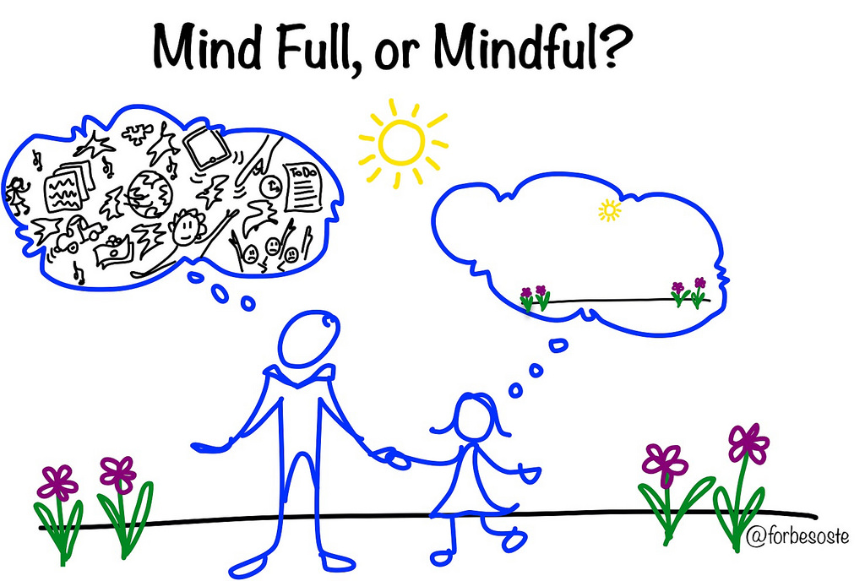
Strategies: Calming Down
Notes:
Relaxation; help your child identify things that help them relax. Help them learn some relaxation exercises
Activity; Mindful re-focussing; in the event of feelings of high anxiety or panic, it can be useful to try strategies which help refocus the person back into the present and away from the preoccupation of their anxiety. A simple technique can be asking the young person to think of the following;
Activity read out 5,4,3,2,1
5 things you can see; eg. A window, a door, the floor, a person, a book
4 things you can feel; eg. Feet touching the floor, legs touching the chair, a pen in their hand, fingers touching together
3 things you can hear; eg, birds outside, people walking past, cars in the distance
2 things you can smell; eg, cold air, a stuffy indoors type smell
1 deep breath or 1 thing you can taste; a sweet they ate earlier

Slide 13

Strategies: Relaxation
Breathing exercises
Muscle relaxation exercises
Guided imagery / Meditation
Notes:
Give out handouts: can also be done as a group activity
Breathing exercises sheet.
Muscle relaxation sheet.
Guided imagery / meditation; choice of Magic Shell meditation or The Big white House meditation.

Slide 14
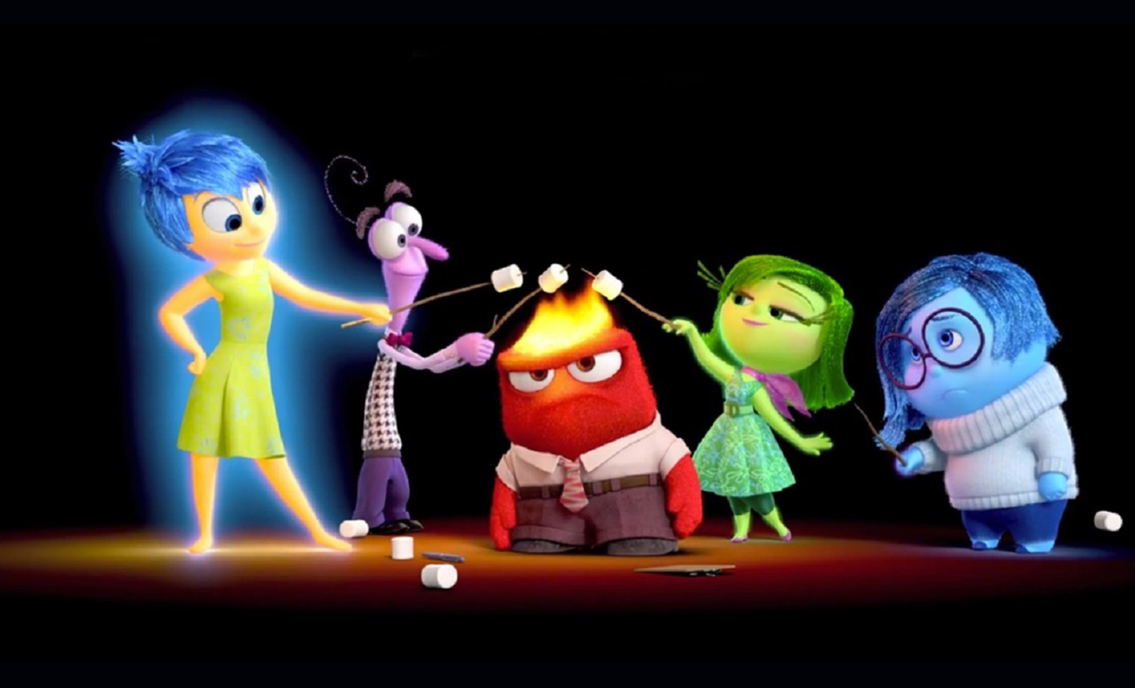
Strategies for younger children that you can do at home together
Talk about the characters in books
Look at the different emojis
Make some feelings cards
Watch the Disney Film inside out together
Notes:
Books at home - talk to your child about how they think the different characters feel.
Feelings cards – create cards by drawing pairs of different feelings on paper or card then play a matching pairs game or snap.

Slide 15
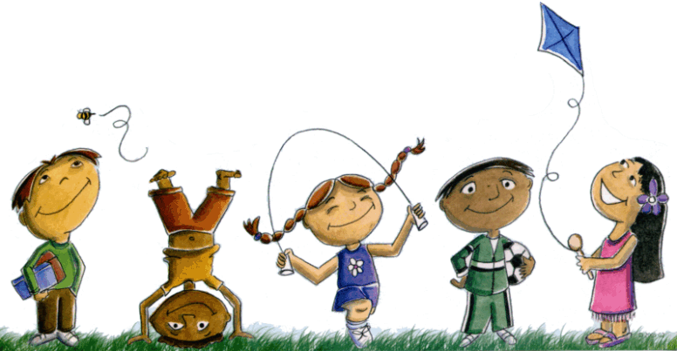
More Strategies
Absorbing activities
Physical activity
Self Talk
Notes:
Absorbing activities can be things such as reading, drawing, colouring in, listening to music, walking (mindfully), doing puzzles, these can be used as an absorbing activity at times when children are feeling anxious
Physical activity; we know exercise is excellent for lifting mood as it releases endorphins. Mild-moderate activity can help in much the same way with anxiety. However this is to be used as more of a regular preventative measure than a remedy when in the midst of experiencing severe physical symptoms of anxiety (eg, breathlessness) as exercise and panic attacks do not mix!
Self-talk; the power of this should not be underestimated. Letting children know that they choose their own thoughts and that these thoughts generate emotions and consequent behaviours is very empowering. Telling themselves stop! When they notice themselves having negative thoughts, or saying to themselves it is okay, this wont last, it happened before and I was fine, yes I can breathe, its just my body’s alarm system, there is no threat are all useful aspects of self talk

Slide 16
Things to consider…
Is the anxiety developmentally appropriate?
To what extent is the anxiety causing the child distress or interfering with his/her everyday functioning?
Is the child showing other symptoms – e.g, depression, weight loss/gain?
How do you usually respond to the anxiety?
Notes:
Family response to the anxiety: Are parents or others unknowingly reinforcing the anxiety by being overly concerned, giving too much reassurance, or giving in to it? To what extent are they helping the child to cope effectively with the fear or anxiety?

Slide 17

When to seek extra support from your GP
Where anxiety has significant impact on daily life
When the child has multiple symptoms of anxiety
When anxiety creates barriers to learning
When the child or parent is very distressed by the symptom (s).
Where there is felt to be risk of significant harm to the child or another person.
Notes:
Barriers to learning: for example, the child cannot access certain lessons, eg: PE.
The young person is very reluctant to go to school, and is not managing to maintain full attendance.

Slide 18

Notes:
Questions and feedback

